Slide 1
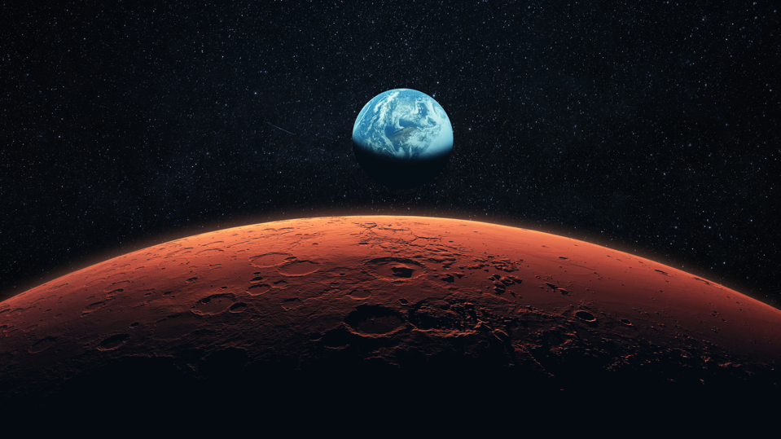
Martian Pathfinders

Slide 2
Overall Design
Launch October-November 2024.
- Hyperbolic trajectories to escape/enter the circular parking orbits around Earth/Mars - Non-Hohmann both to Mars and on return, but overall optimises fuel and time taken
Optimised for time of transfer, within our fuel constraints (including reserve fuel).
Launch in Queensland - Pre-existing infrastructure - Range of available launch inclinations
Notes:
Launch in Oct-Nov to give Non-hohmann in both directions, ultimately optimising fuel usage as well as time
Range of launch inclinations means we can account for changes in transfer manoeuvres

Slide 3

Earth SOI
Calculation yields the following SOI radii:
Earth: r_soi_E = 924,663 km ≅925,000km
Two-body systems were assumed (other gravitational forces e.g. the Moon, Jupiter… are ignored)
Optimise parking orbit to minimise ΔV for transfer, adjust inclination
Design: Circular parking orbit, Parallel elliptic parking orbit, Apotwist parking orbit, Altitude

Slide 4
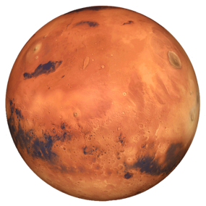

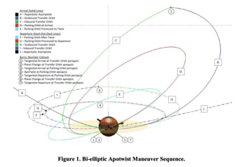
Mars SOI
Calculation yields the following SOI radii:
Mars: r_soi_M = 1,408,629 km ≅ 1,409,000 km
Optimise parking orbit to minimise ΔV for transfer
Meet mission requirements: Landing craft to collect samples from Martian surface (3-4 months => precession, perturbation)
Design: Circular parking orbit, Parallel elliptic parking orbit, Apotwist parking orbit, Altitude => phasing manoeuvre vs EDL
Min Qu et al. NASA’s Human Spaceflight Architecture Team (HAT)

Slide 5
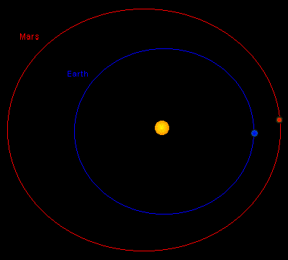
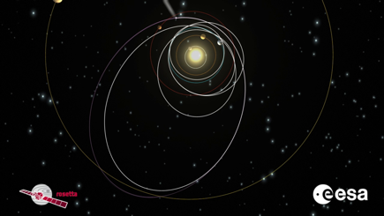
Interplanetary Transfer
Earth vs Mars Orbit
Mars Orbit has 5.5x Eccentricity (~0.0935)
1.85 degree inclination difference
Transferring between Earth and Mars
Hohmann
Non-Hohmann
Fuel Reserve
For correction and phasing manoeuvres
Gravitational Assists from Earth
Notes:
The orbit of mars when compared to mars is clearly larger than Earth’s. It’s eccentricity is 0.0935 which is much larger than Earth’s (approx. 5.5x). As a result, a transfer that arrives at the aphelion will have noticeable changes in delta v requirements compared to an orbit that reaches mars at its perihelion. These differences will be further analysed and compared, it is my current opinion that an orbit that arrives at or around the aphelion will be important.
The difference in inclination angles between the orbit of Earth and Mars is approximately 1.85 degrees. Ideally, an orbit with no plane change would be used as this would minimise the required delta v. This will be affected by the launch sites which Dillon will discuss.
Transferring from the Earth’s orbit to the parking orbit of Mars will take the following manoeuvres. First we would require a hyperbolic trajectory to leave Earth’s Sphere of Influence. From this escape of Earth’s SOI, we can either conduct a Hohmann transfer or a non-Hohmann transfer. Hohmann transfer is most efficient and the Non-Hohmann transfer can be much faster but much less fuel efficient. Once we intercept Mars in its orbit, we must then manoeuvre such that we enter a homing orbit around mars. Finally, we conduct the same manoeuvres to travel from Mars back to Earth. To determine the optimal transfer, we would like to optimise both the time taken as well as the fuel required. To optimise the fuel required, we will analyse the amount of reserve fuel we might require, and from here, use the remaining fuel to optimise the time which the transfer will take.
As Olivia will cover soon, with a parking orbit duration of 3-4 months, we cannot have a hohmann transfer from Earth to Mars as well as Mars to Earth. For this reason, I believe we will complete non-hohmann transfers that optimise the total amount of fuel required. The equations and solutions for this will be defined this week.
It is really important that we don’t use all of our fuel on our interplanetary trajectories. We want to be able to use some for manoeuvres within the parking orbit of Mars as well as for corrections due to errors that may occur throughout the transfer.
Last thing I’ll cover is the possibility of gravitational assists to further minimise the required fuel to reach the orbit of Mars. We can design a transfer that would complete multiple successive orbits with large eccentricities such that they each leave the SOI of Earth.
When we enter the SOI again of Earth, if we enter in the direction in which Earth rotates around the Sun, we will receive a gravity assist. However, the modelling of this transfer would be substantially more difficult. Therefore, unless it is found to be necessary when we analyse the delta V’s of our current transfer methods, then this method will be avoided.

Slide 6

Interplanetary Transfer
Intercepting Mars in its orbit - Determining at what point/time to enter Mars’ orbit
Plane Change Location - Needs to occur at the intersection point between Earth and Mars orbits, minimising Delta V.
Total Delta V - Impacted by the various manoeuvres made during the total transfer trajectory, transfer orbit, plane change, parking orbit etc.
Parking Orbit Manoeuvres - temporary orbit around Earth and then around Mars which the spacecraft will be placed in.
Notes:
Intercepting Mars in its orbit - Designing the trajectory such that the spacecraft arrives at Mars at a specific time in its’ orbit
such that the location of Mars arrives in the apse line of the transfer ellipse at the same time as the spacecraft.
The inclination of Mars orbit around the sun is 1.848 degrees while Earth’s orbit is 0 degrees, hence the plane change must be 1.848 deg (the difference between the two orbit inclinations).

Slide 7
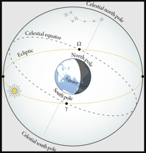
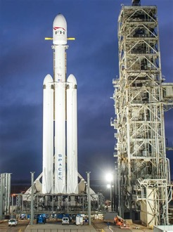
Spacecraft and Launch Location
Spacecraft
Falcon Heavy max 63800 kg to LEO
Or 16800 kg to Mars
Minimum 500 kg dry mass
Launch Locations:
Minimum possible inclination 10.114 degrees
Other missions to Mars launched from Cape Canaveral at 28 degrees
Queensland:
Major Infrastructure
Launches over sea

Slide 8
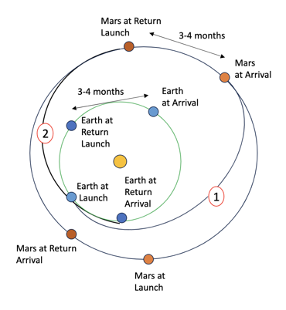
Launch Window & Timing
Optimal launch window: every 2.13 years → next one Oct-Nov 2024
Wait time: 3-4 months (90-120 days)
Return window: 3-4 months later (Sept-Nov 2025), where Mars will have moved through approx. 13-17% of its orbit, and Earth 25-32%
Notes:
The optimal launch window to complete a Hohmann transfer from Earth to Mars occurs according to the synodic period, which is every 2.13 years. Based on the range of the last launch window, the next one occurs from October to November of 2024. Although a Hohmann transfer can be conducted for the trip to Mars, one cannot be undertaken for the return trip, since the optimal wait time (of approximately 454 days) is not being applied, and rather, a wait time of only 3 to 4 months (or roughly 90-120 days) is required. If a Hohmann transfer is conducted from Earth to Mars, when the satellite reaches Mars, it must be opposite Earth’s position at the time it departed Earth (for rendezvous). However, at the onset of the return trip, Mars will have moved through approximately 13-17% of its orbit dependent on the timing chosen, and Earth 25-32%. The wait time must be carefully selected based on the relative position of Earth to Mars.

Slide 9
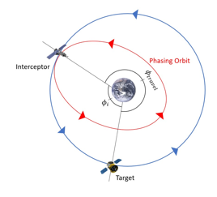
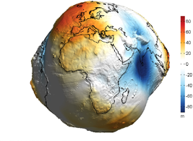
Robustness & Flexibility
Phasing manoeuvres to account for errors in launch time
Initial findings:
larger parking orbit → smaller Δ𝒱 required
however it will compromise the hyperbolic escape trajectory Δ𝒱
Consider J2 perturbations for robustness

Slide 10
Integration and Results
Mars’ orbit is 1.85 degrees more inclined so launch location ideally between -10.114 and -23.4 degrees in latitude
Optimal Launch window Oct - Nov 2024 for Hohmann transfer
- Key data: - Phasing manoeuvre simulation:
Parking altitude | Corresponding Δ𝒱 (km/s) required for time error (% of a day)
 | 0.01% | 0.05% | 0.1%
500 km | 0.0077 | 0.0389 | 0.0784
750 km | 0.0072 | 0.0362 | 0.0730
1000 km | 0.0067 | 0.0338 | 0.0681
Earth SOI radius | 924,664 km
Mars SOI radius | 1,408,629 km
Heavy Falcon Payload | 63800 kg

Slide 11
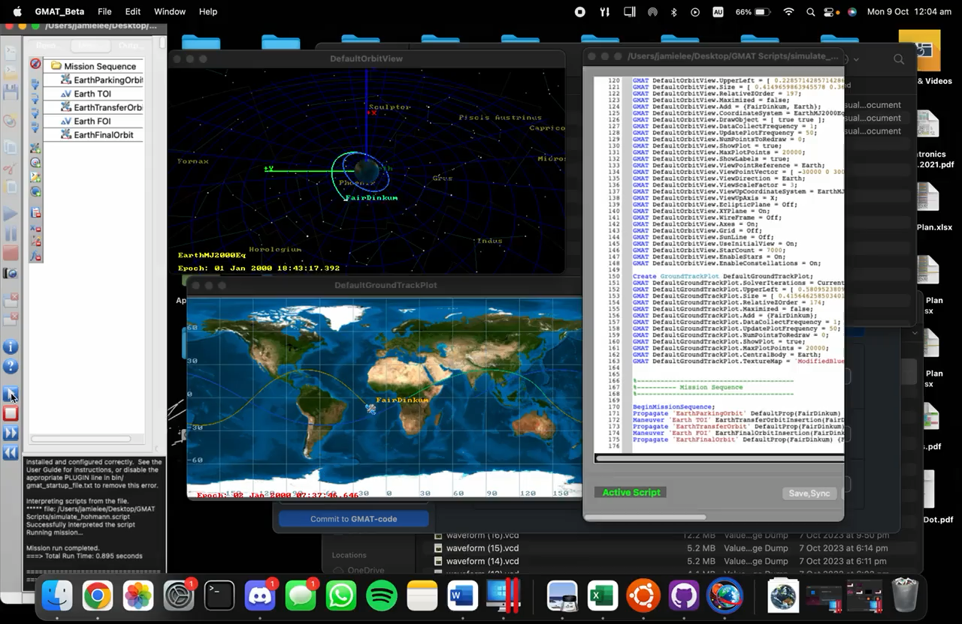
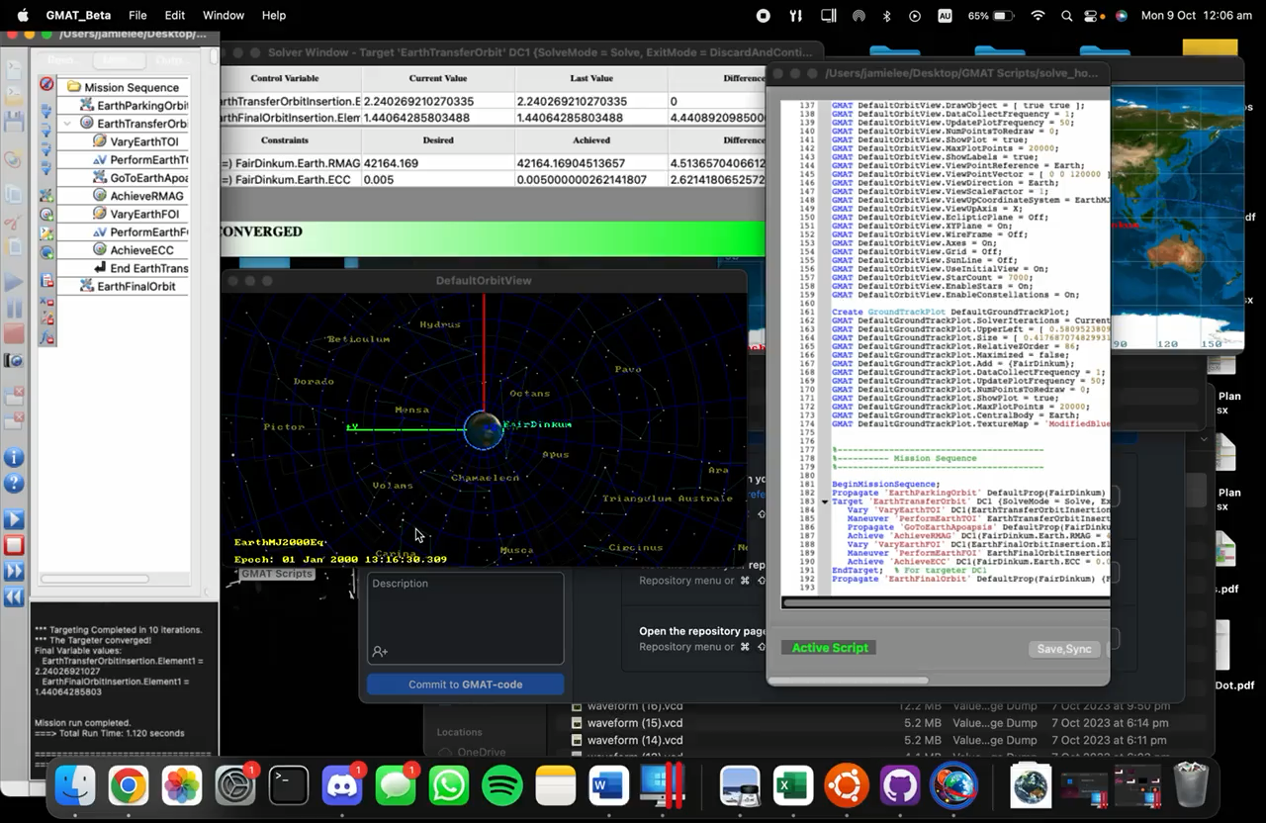
GMAT
Simulated Hohmann Manoeuvre in Earth Orbit
given Impulsive Burns
Solved Hohmann Manoeuvre in Earth Orbit
given Target Orbit

